Slide 1
Scuba Chat
Project Update 4/19
Akshaya Bhat, Lilian Vu, Sienna Landa, Sophie Harris

Slide 2
Project Overview

Slide 3

Project Objective
Create an underwater transmitter and receiver using a piezoelectric transducer to generate ultrasound waves
Implement the transceiver on our PYNQ FPGAs and ARM cores, with analog elements limited to the transducers, amplifiers, and a bandpass filter on the receiver side.

Slide 4

Minimum Viable Product (MVP)
Basic Goals:
Successfully send information over the underwater acoustic channel
Prototype PYNQ boards with waterproof transducer cabled to it that can be dipped several feet into the water or a swimming pool or lake to send data
Create one Transmitter and one Receiver for one way communication.
Have a high enough data rate to send small snippets of text without noticeable delay
Bit error rate should be around 1% (10⁻²)

Slide 5

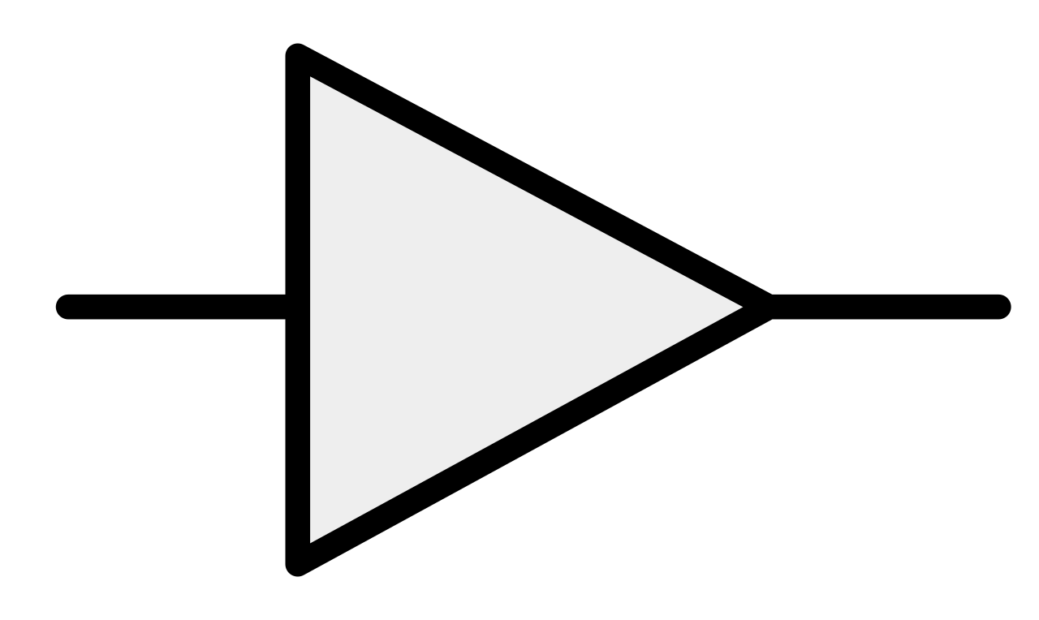
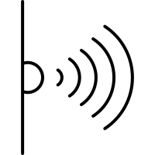
Block Diagram
PYNQ
ARM
FPGA
40kHz
Waveform Generation
Encoding
QPSK Modulation
DAC
Display
Decoding
QPSK Demodulation
ADC

Slide 6
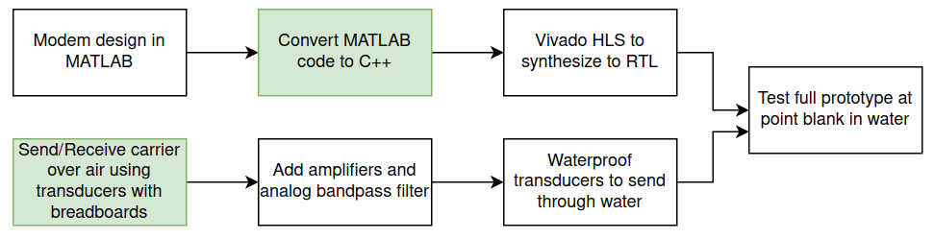
Design Flow
Work In Progress

Slide 7
Group Management
Software Team
Hardware Team
Sophie
Matlab implementation of Tx and Rx
Translate Matlab to C++ for Rx
BER Simulations in Matlab
Matlab simulation of the Channel
Akshaya
Viterbi decoder (software)
Integrate Amplifier with the transducer circuit.
Basic underwater signal TX/RX testing.
Programming the transducer connected to PYNQ.
Collaboration
Overall integration
Testing
Debugging
Discussions
Lilian
Translate Matlab to C++ for Tx and Rx
DMA testing with FPGA IP Core on PYNQ
DAC/ADC Integration with PYNQ
Sienna
Standalone Circuit design for transducer interface
Integrate Amplifier with the transducer circuit.
Basic underwater signal TX/RX testing.
Programming the transducer connected to PYNQ.

Slide 8
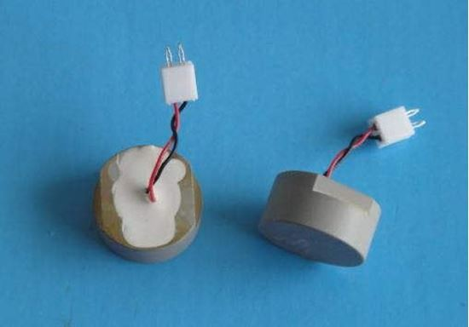
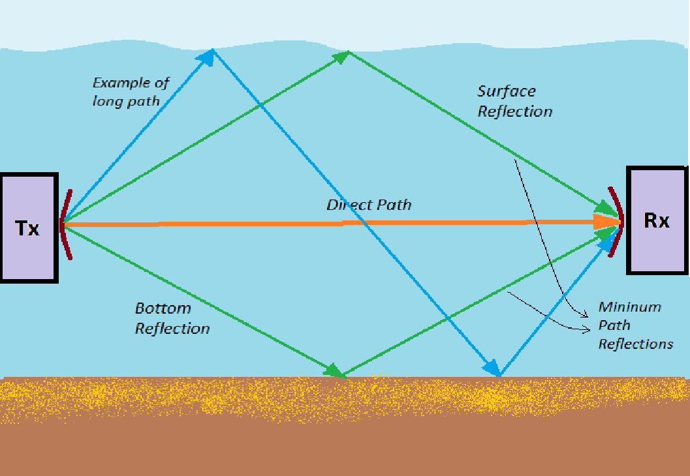
Major Concerns/Risks
Hardware
Communication between Tx and Rx Transducers
Analog filters, amplifiers, and other components
System Integration
Erroneous synchronization of samples coming from ADC
Incorrectly handling DMAs
Underwater Channel
Real physical channel could be unpredictable, maybe our receiver can’t handle it

Slide 9
Software - Simulation

Slide 10
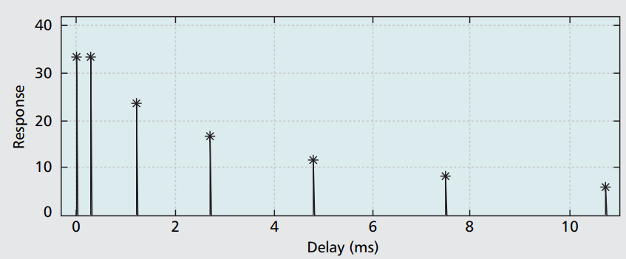
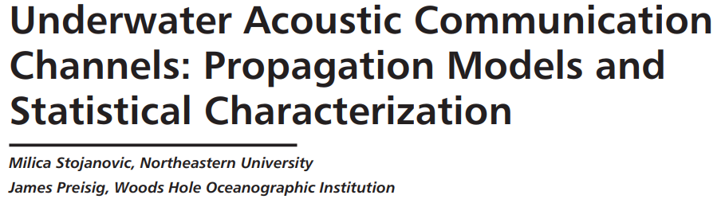
Simulation Parameters
Preamble Length: 64 bits
Data Length: 128 bits (random)
Sampling Frequency: 128 kHz
Carrier Frequency: 40 kHz

Slide 11
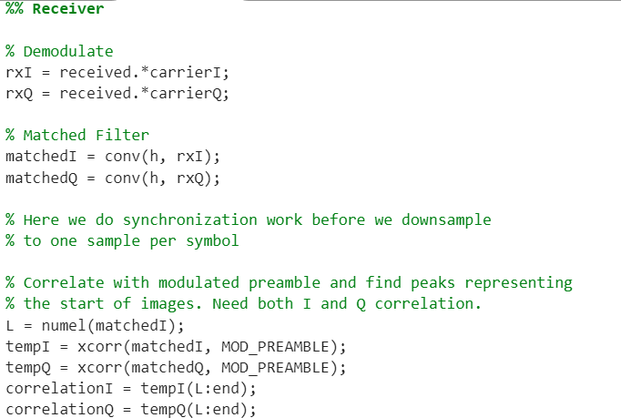
End to End Matlab Simulation

Slide 12
Problems: Bad Inputs?
Certain input bits always result in high error
(e.g.) I: 0001100011100010100011111100100100001001100000101100111101101000
Q: 1101110001011111101010111001111011101111110001100001100111101010
Results in 25 errors for I, 23 errors for Q
Other input bits generally result in zero errors
(e.g.) I: 0010010001100110011101000001011101010110010001000100011101100110
Q: 1000101110101010101100001111101111001010101000010000010000110001

Slide 13
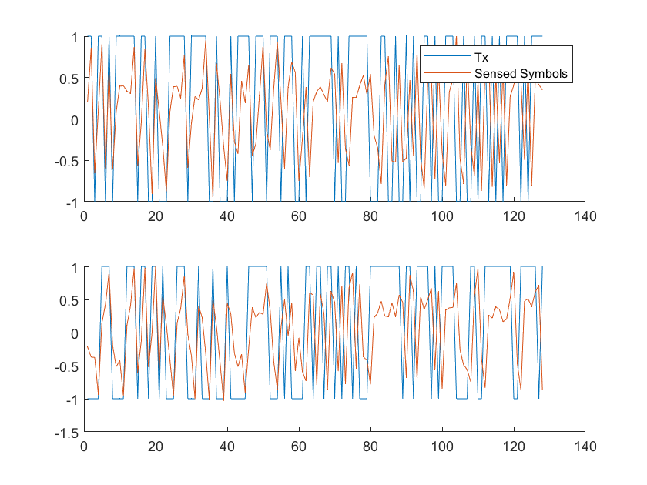
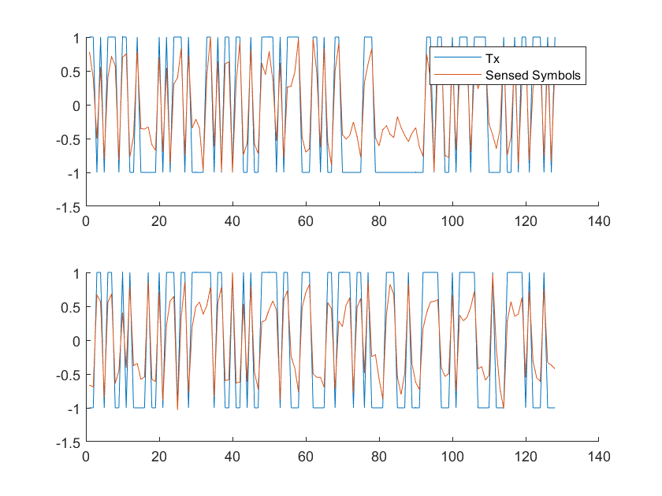
Tx vs Rx Symbols
Bad Input
Other Inputs

Slide 14
Problems: Occasional off by one with good inputs?
In an experiment where the same input data is sent repeatedly over a noisy channel, one of every few hundred packets gets terrible results (40%-50%) error, while the rest have 0% error
This occurs when a simple gaussian noise channel is used, but not with the more complex channel derived from experimental papers
The issue disappears when the same noise vector is applied each time (scaled for SNR)

Slide 15
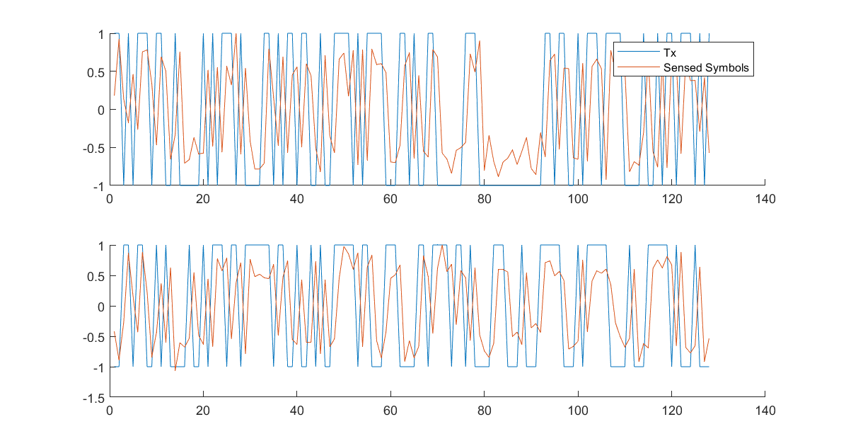
Problems: Occasional off by one with good inputs?
In an experiment where the same input data is sent repeatedly over a noisy channel, one of every few hundred packets gets terrible results (40%-50%) error, while the rest have 0% error
This occurs when a simple gaussian noise channel is used, but not with the more complex channel derived from experimental papers
The issue disappears when the same noise vector is applied each time (scaled for SNR)

Slide 16
Problems: Occasional off by one with good inputs?
In an experiment where the same input data is sent repeatedly over a noisy channel, one of every few hundred packets gets terrible results (40%-50%) error, while the rest have 0% error
This occurs when a simple gaussian noise channel is used, but not with the more complex channel derived from experimental papers
The issue disappears when the same noise vector is applied each time (scaled for SNR)
Without this issue, I see absolutely no error even at -4 dB SNR

Slide 17
Summary
The simulation transmitter and receiver work perfectly, except when they totally fail
The issue we see involves the sensed symbols being shifted in one direction or the other from the transmitted symbols, leading to an off by one error and 40-80 errors out of 128 bits transmitted
We need to move on to get the Rx working on the FPGA, but it is still important to resolve this problem at some point

Slide 18
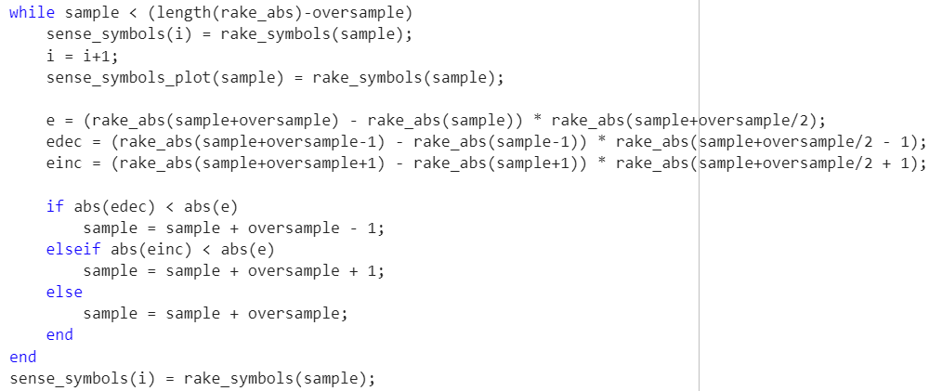
Update: Figured it out
Turns out using a symbol timing recovery algorithm doesn’t make sense when you’ve already sampled at a high rate.
Off by one was caused by drift I introduced with the gardner algorithm
The appropriate solution for any timing issues we have is a PLL to handle doppler

Slide 19
Software - C++/Synthesis

Slide 20
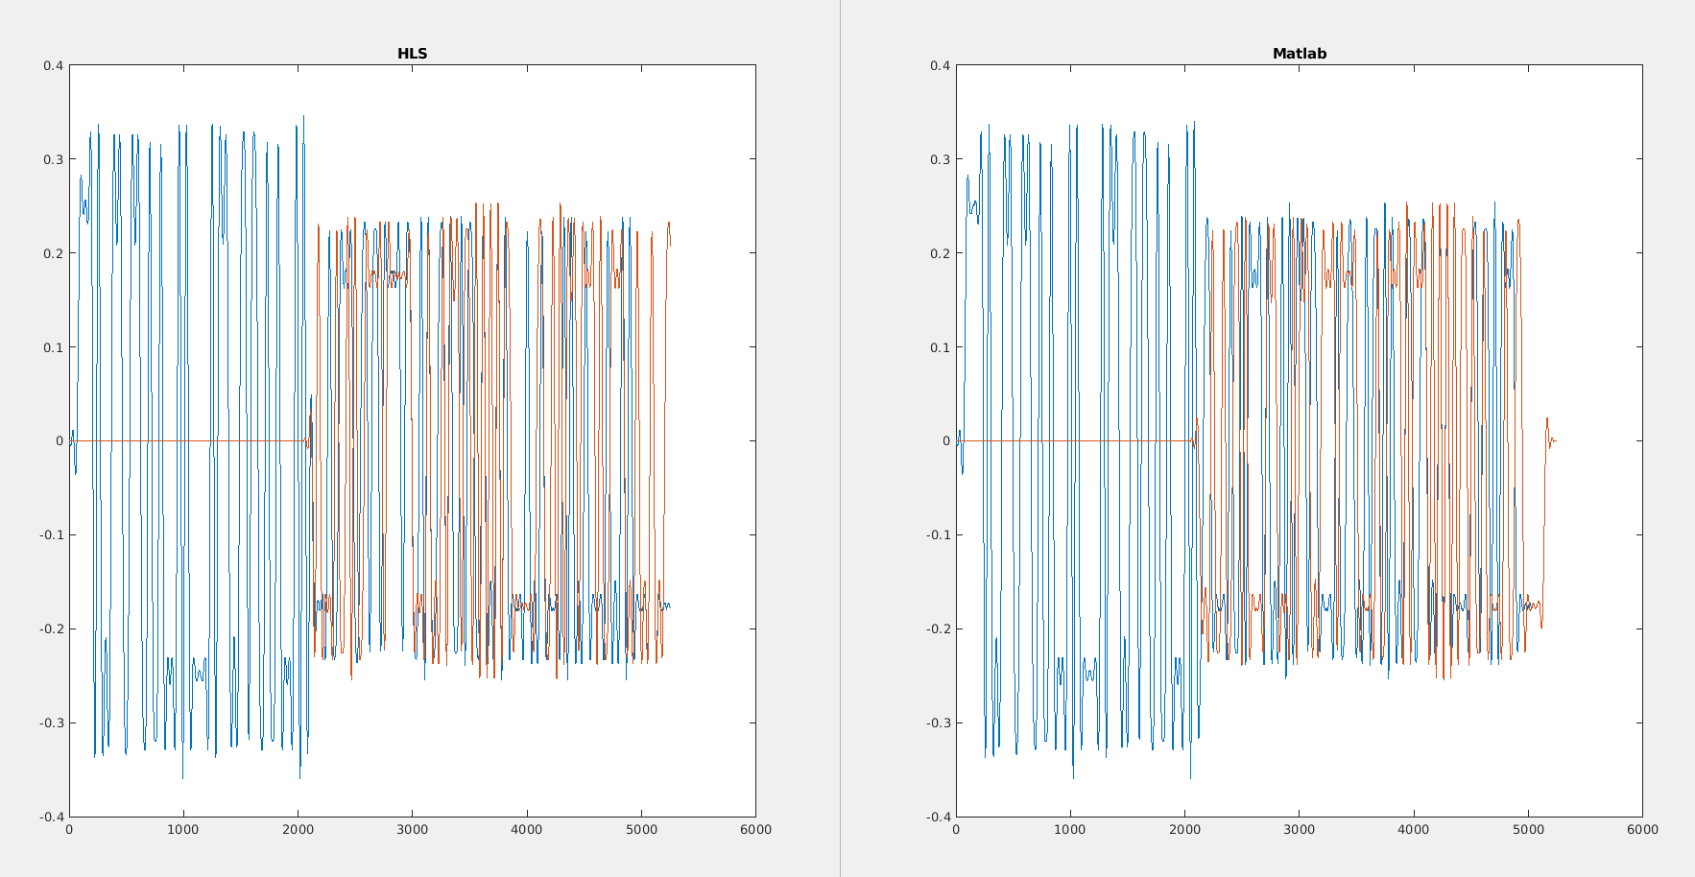
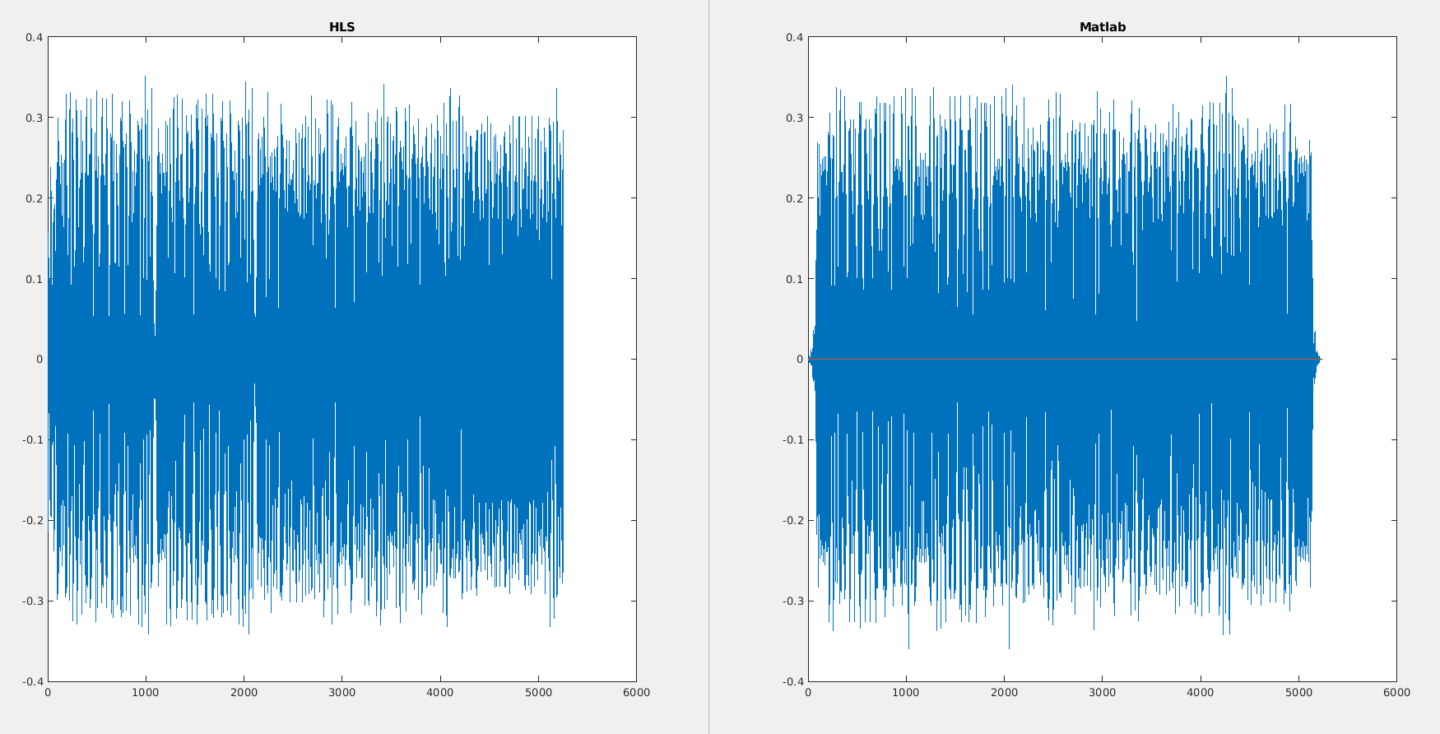
Matlab/HLS Comparison

Slide 21
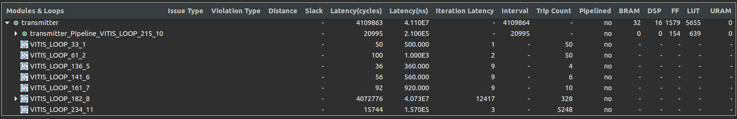
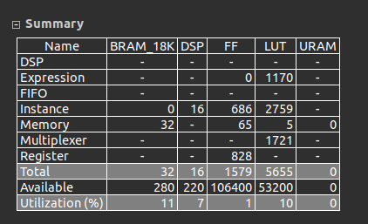
HLS Synthesis
Optimizations to consider:
dataflow
array partition
pipeline
loop unrolling
fixed point
structure (separate loops)

Slide 22
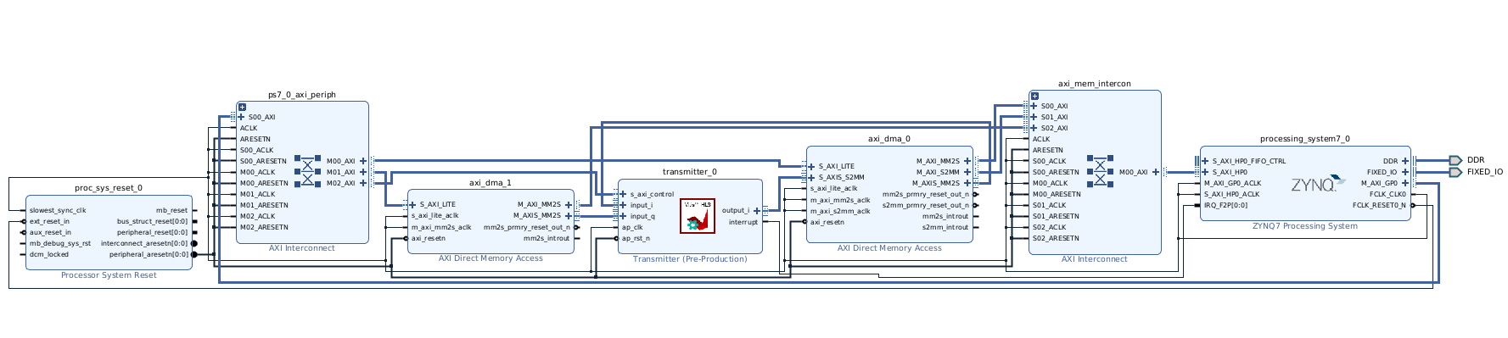
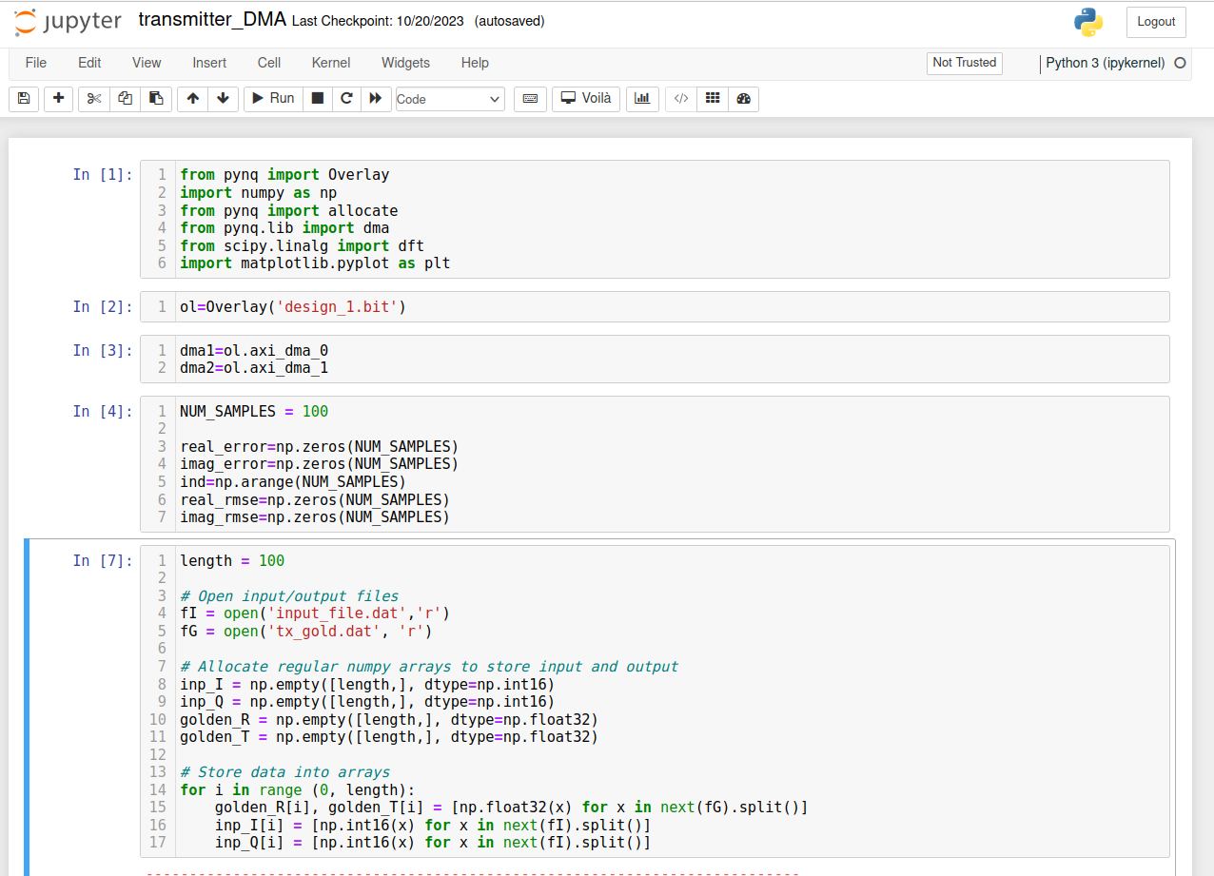
Current: Tx DMA

Slide 23
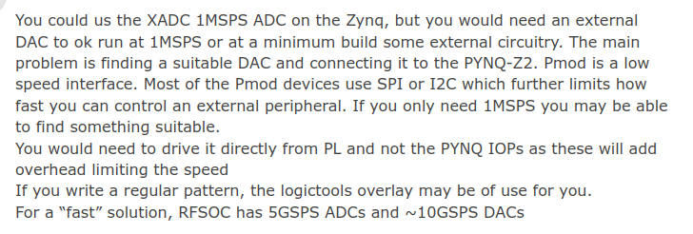
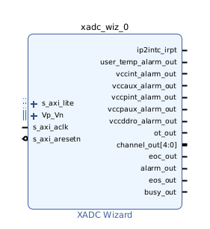
Next: DAC to ADC
Do a separate project DAC → ADC project to understand behavior of components
Research about DAC and ADC for Pynq-Z2
From forums, the Z2 doesn’t output analog directly. A PMOD External DAC is necessary for this.

Slide 24
Hardware

Slide 25

Hardware Progress
Tx Transducer outputting random values while connected to the PYNQ
Rx Transducer able to read values while connected to the Arduino
Rx Transducer able to ignore a threshold of noise, like a finger in the water

Slide 26
Hardware Progress
Tx Transducer outputting random values while connected to the PYNQ
Rx Transducer able to read values while connected to the Arduino
Rx Transducer able to ignore a threshold of noise, like a finger in the water

Slide 27
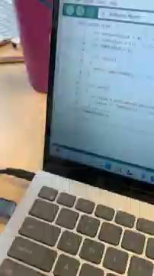
Hardware Progress
Tx Transducer outputting random values while connected to the PYNQ
Rx Transducer able to read values while connected to the Arduino
Rx Transducer able to ignore a threshold of noise, like a finger in the water

Slide 28
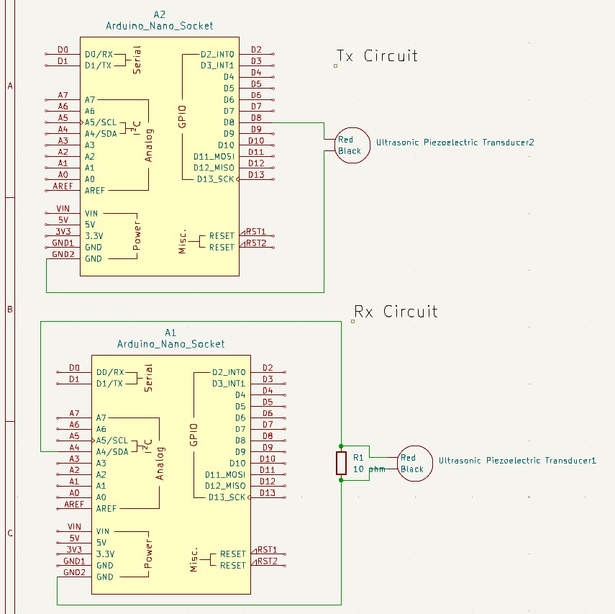
Hardware Progress
akshaya-bhat/UnderWaterCommunications (github.com)

Slide 29
Next Sprint Goals

Slide 30
Goals for the next 2 weeks
Hardware
Integrate Rx Transducer with PYNQ
Test Tx Transducer with C++ Synthesis on PYNQ
Software
Settle on a sampling rate / number of pulse shaping taps that balances performance with resource usage
Connect transmitter to DAC via DMA and load bitstream to PYNQ
Write a first pass at C++ receiver code

